Slide 1

Relationships between Breed, Temperament, Intelligence and Guide Dog Success: Do different breeds of guide dog program puppies affect behavior and ultimate success as a guide dog?
Sarah Colbert

Slide 2

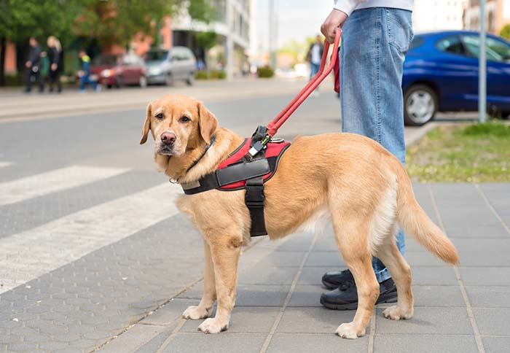
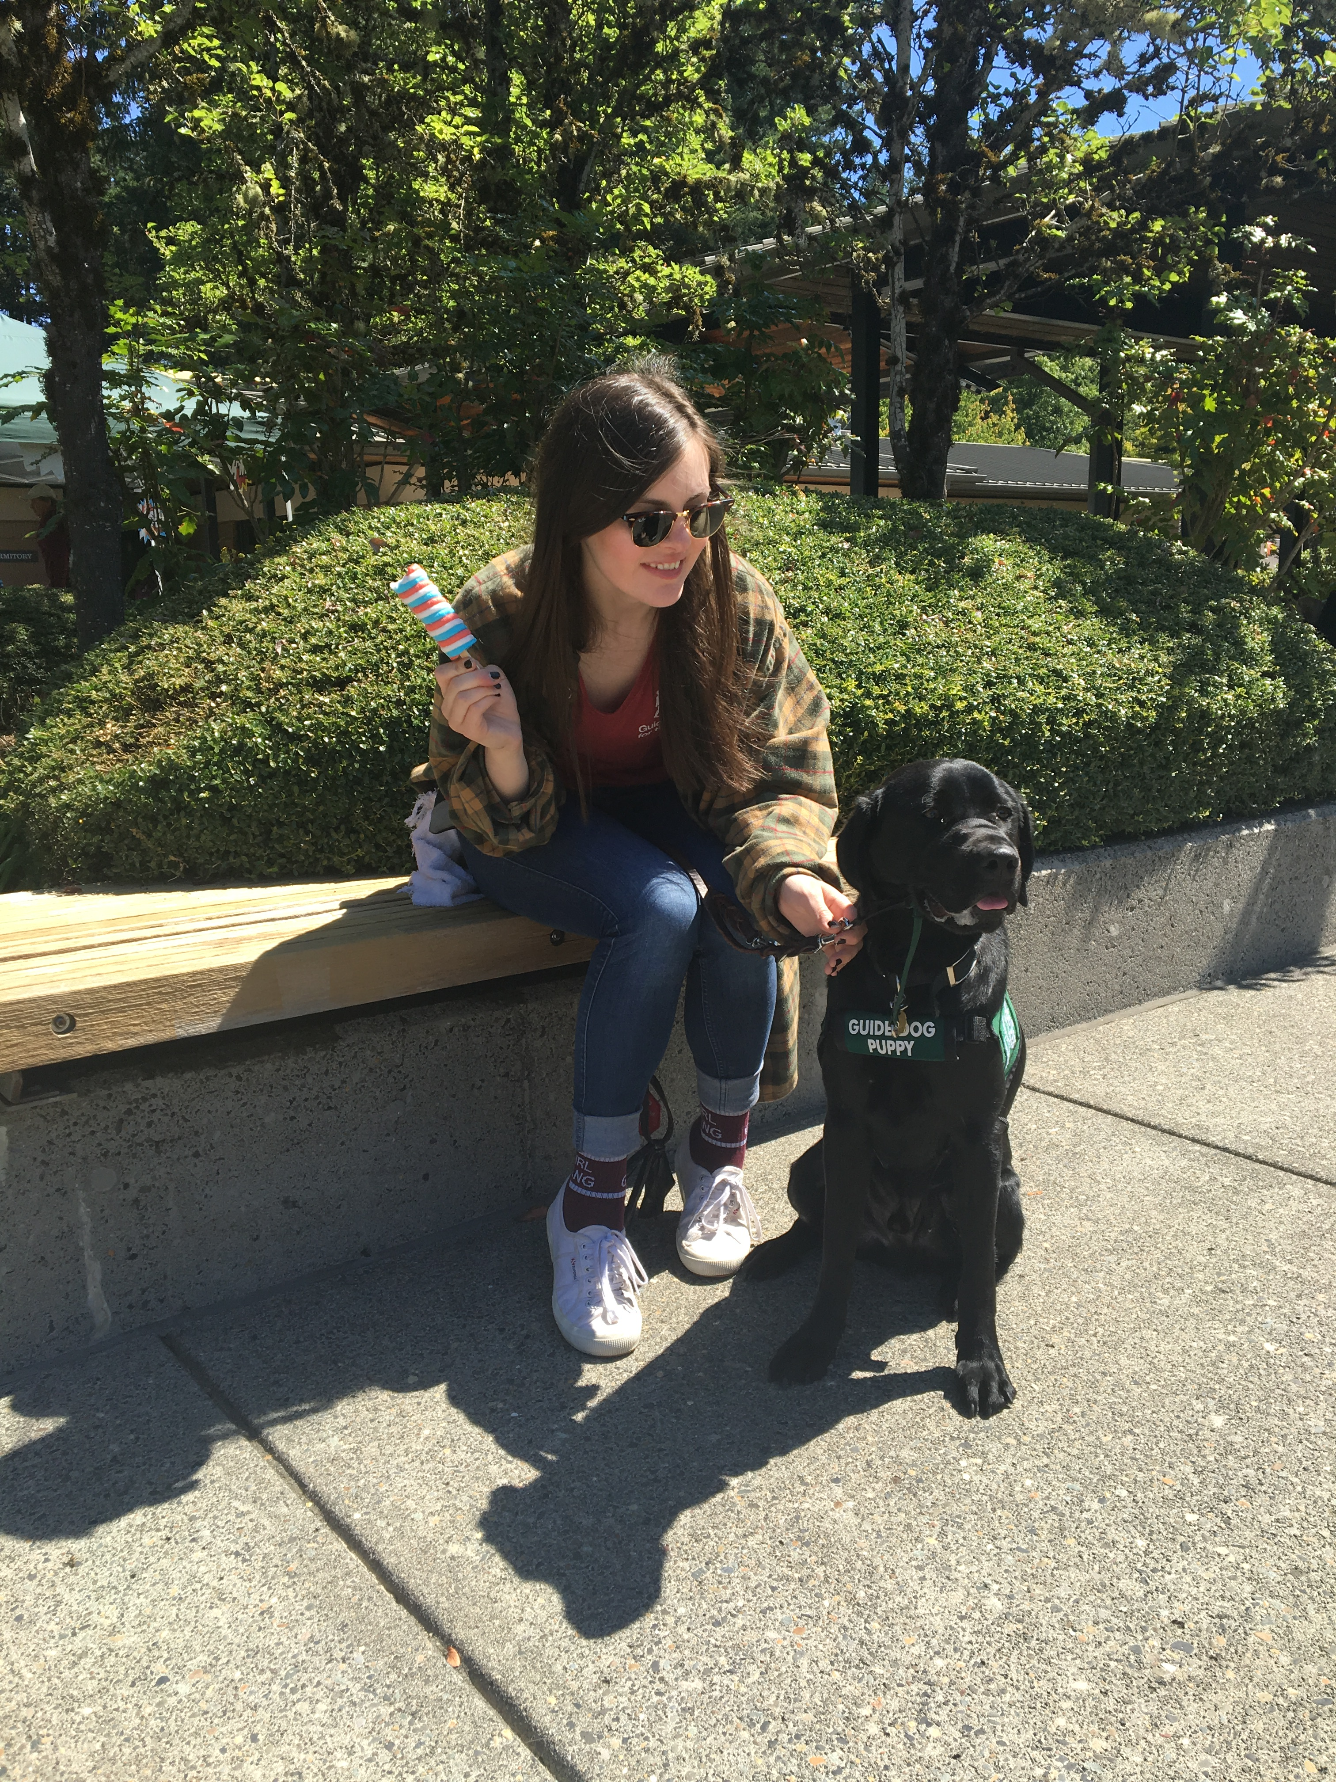
Background and Motivation
Background:
Many factors determine if a dog is suited for guide work
What are the non-environmental factors?
Personal motivation: I was a guide dog puppy raiser! →
Researchers’ motivation: In humans and other animals, to what extent do cognitive skills and temperament contribute to “successful” outcomes?
https://topdogtips.com/tool-best-guide-dog/

Slide 3

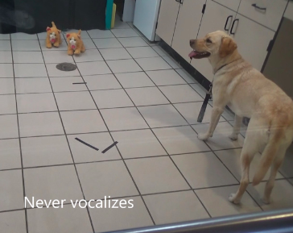
I will answer my research question by using the following data set from Dryad: Effects of maternal investment, temperament, and cognition on guide dog success
The Study:
Followed guide dog program puppies from age of ~2 weeks to completion of program (age varied)
Created eleven tasks for dogs to complete
Each task measured several variables in order to measure cognitive skills/intelligence and temperament
Performed Odds Ratio tests to determine odds of certain traits aligning with success or failure in the program

Slide 4
About the Data
133 puppies
Puppy characteristics: failure or success, litter, sex, birth season, litter size, breed, test age
Excel spreadsheet (will need to be converted to csv and lots of subsetting/removing of data!)
Z scores for variable performance
Principal components derived from Z scores

Slide 5
Anticipated Details
Subsetting the data by breed and specific variables to be looked at
Several one way ANOVA tests:
Breed and success
Multi step problem solving abilities and success
Tendency to vocalize when introduced to a novel object and success
Reactions to umbrella opening and success
Graphics/Visuals
Average success rate for each breed for each variable
H₀ : avg success rate of goldens = labs = shepherds
H₁ : at least two breeds’ average success rates are significantly different

Slide 6
Anticipated Results
From my background knowledge and information provided to me when I volunteered as a Guide Dogs for the Blind puppy raiser I know that different breeds had different rates of success (part of the reason my program did not use German Shepherds, only Labradors and Golden Retrievers)
Reject the null
Difference in behavior for each breed and how important those behaviors are for each breed’s success
Research paper did note that poor performance by goldens in some tasks did not impact success as much as it did for other breeds (does the extra cute fluffiness let them get away with lower performance??)
https://www.akc.org/dog-breeds

Slide 7
References
Bray EE, Sammel MD, Cheney DL, Serpell JA, Seyfarth RM (2017) Effects of maternal investment, temperament, and cognition on guide dog success. Proceedings of the National Academy of Sciences of the United States of America 114(34): 9128-9133. https://doi.org/10.1073/pnas.1704303114
Bray EE, Sammel MD, Cheney DL, Serpell JA, Seyfarth RM (2017) Data from: Effects of maternal investment, temperament, and cognition on guide dog success. Dryad Digital Repository. https://doi.org/10.5061/dryad.50fj0

